Slide 1
Final Project BDAT 1004 Web Application: StockQuote
Data Programming
Instructor: Roshan Sahu
Georgian College

Slide 2
Project Summary
1. Acquisition of a data source from: https://merolagani.com/StockQuote.aspx,
3. User interface
HTML,CSS ,bootstrap and flask.
SQL Phyton
Web Application:
StockQuote
2. Store acquired data in a database
In Mongo DB and SQL Phyton
4. Display results
Matplotlib and Pandas

Slide 3
Team Profile
Project Manager and Business Analyst:
Monica Cubas
Bachelor's Degree in System Engineering
Python Developer
Data Analyst
Frontend developer
Deployment of project
Shrutika Kolhe
Masters in technology
Roshan Khatri
Edith de la Cruz Rubianes
Bachelor's Degree in System Engineering
Sonuyesh Upreti
Bachelor in Information Management.
Bachelor in Computer Engineering
Main task:
Main task:
Main task:
Main task:
Main task:
Develop the software front end with VS code, HTML, CSS and Flask.
Deployment of visualizations with pandas and additional libraries.
Monitoring and planning of the project and creating project documentation
Write the batch script in python.
Identify and Extract the information with Python code to get from Pandas DataFrame to SQL

Slide 4
About the Data Set:
Background information
Attributes:
The data set has 8 main attributes:
The company name symbol.
The highest and lowest price of the period.
The initial price.
The total number of outstanding shares available for trading on the public markets.
The total value of shares traded during a specific period
Results to display on the web:
Data extracted from Merolagani.com provides livestock quotes specially designed for Nepal needs.
Graphics with information

Slide 5
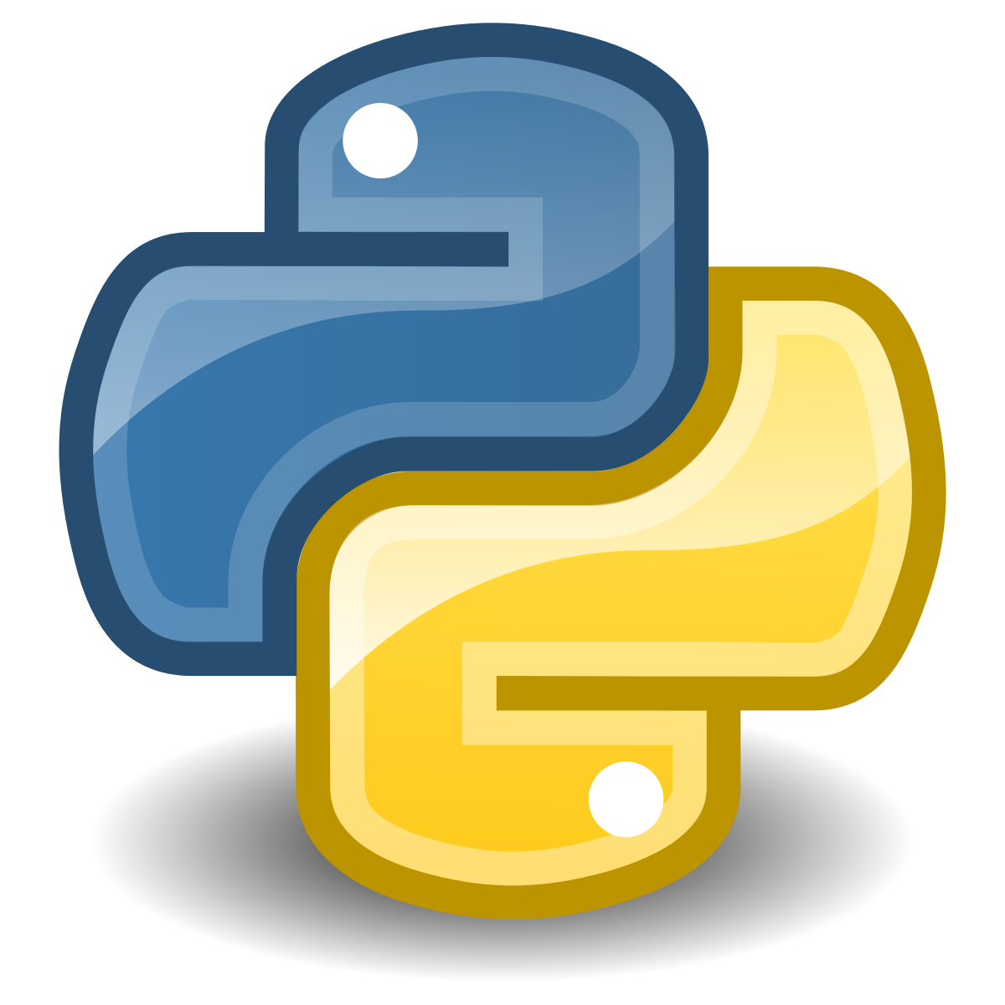
1. Acquisition of a data source from a remote source

Slide 6
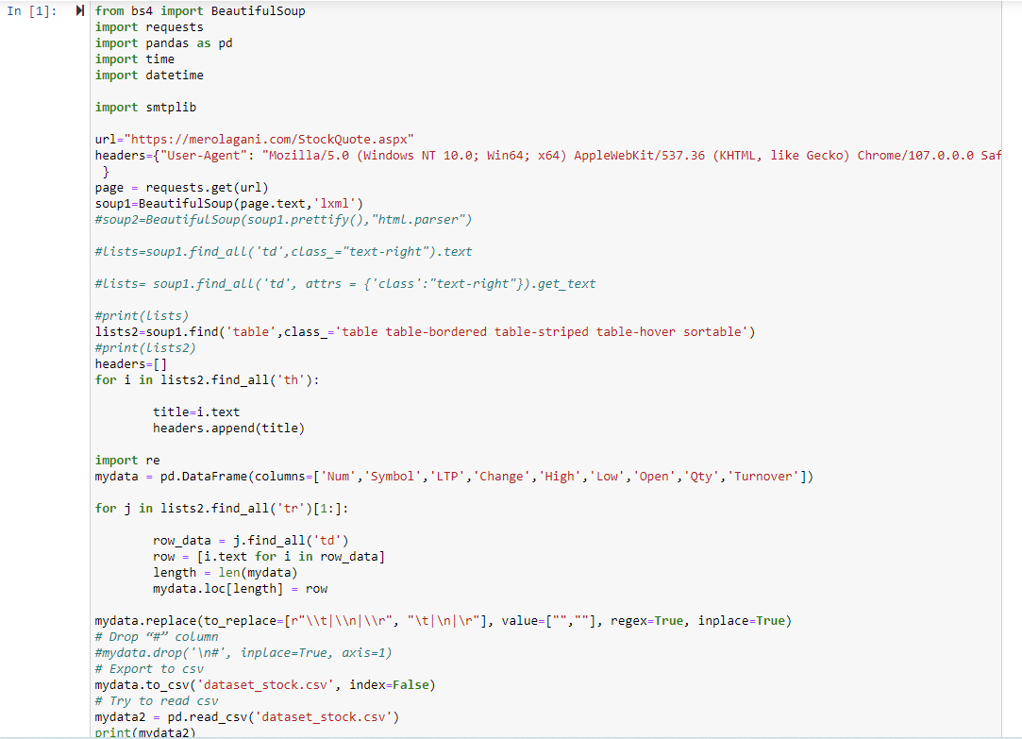
Tools for extracting the dataset:
Web Scraping which is a method of extracting useful data from a website using computer programs without having to manually do it.
Approach:
We imported all the necessary libraries such as BeautifulSoup for extracting data from the stock market and pandas for the Dataframe.
Set up our URL strings for making a connection using the requests library.
Parsing the available data from the target page using the BeautifulSoup library’s parser.

Slide 7
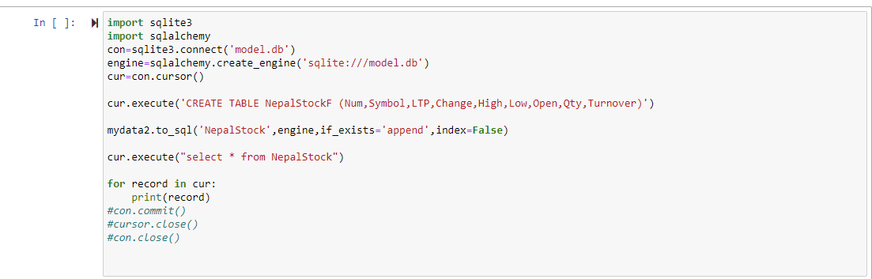
Store into a database

Slide 8
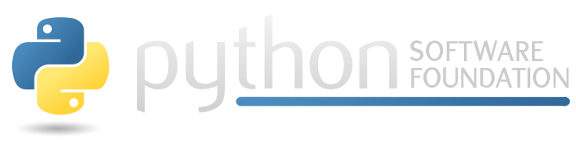
2. Store acquired data in a database

Slide 9
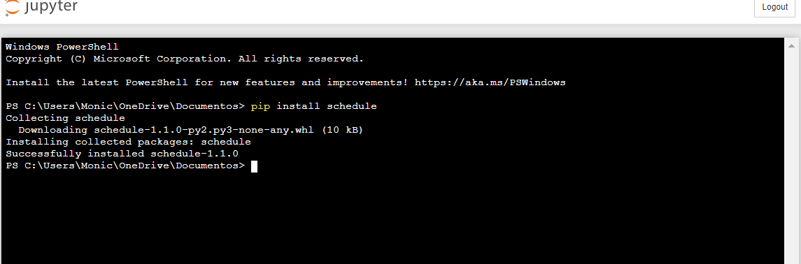
Process that runs every 24-hours to acquire data and store.
We schedule a function to extract the data.
Schedule Library: is used to schedule a task at a particular time.

Slide 10
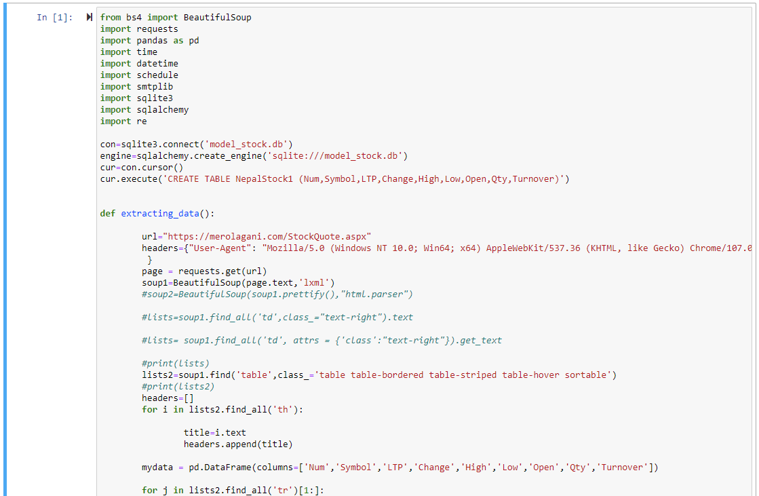
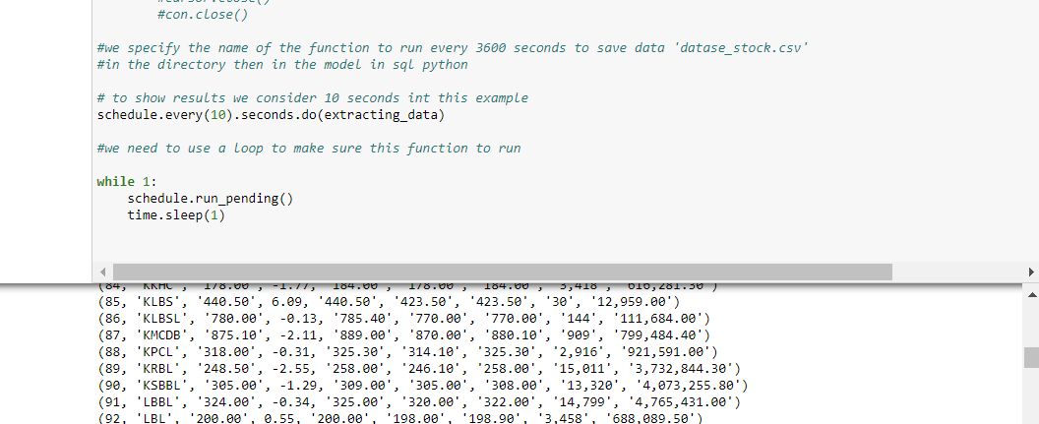
We schedule a function to extract the data.
The name of the function extracting_data() run every 86400 seconds to save data 'datase_stock.csv’ in the directory and then in the model in SQL python and used a loop to make sure this function runs.

Slide 11
3. User interface

Slide 12
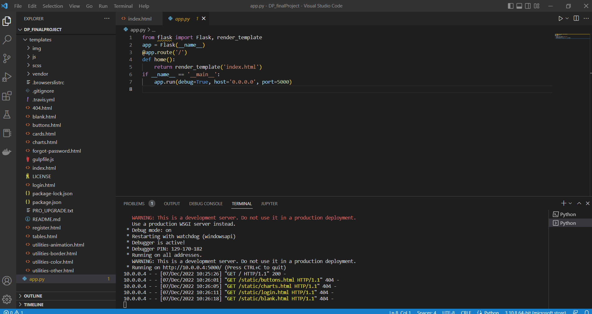
Code Editor:
Visual Studio Code
is a free editor that fully supports Python and useful features such as real-time collaboration.
Frameworks :
Flask
Flask is a small and lightweight Python web framework that provides useful tools and features that make creating web applications in Python .

Slide 13
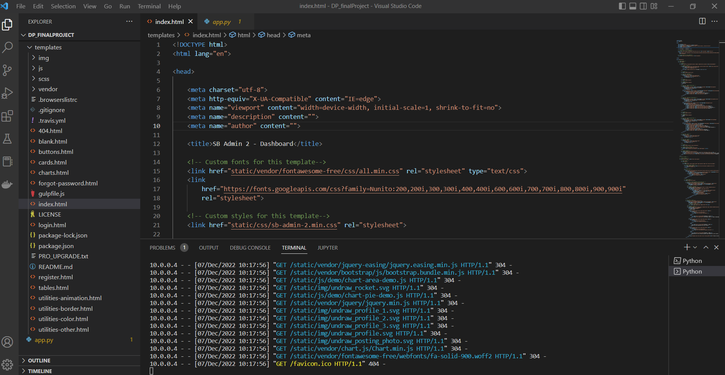
Frameworks :
Bootstrap:
open-source front-end development framework for the creation of websites and web apps. Designed to enable responsive development of websites.
Integrating HTML and css

Slide 14
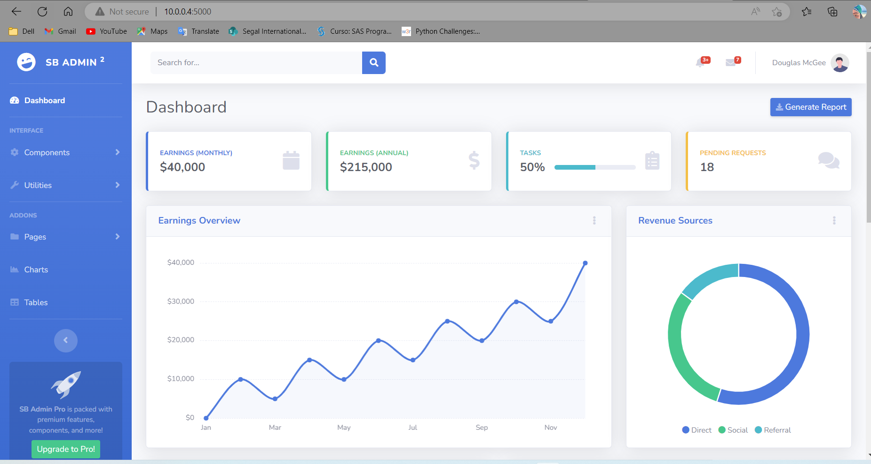
User interface
Our data source cannot be integrated into the template
The visualizations are part of the demo.

Slide 15
4. Display results

Slide 16
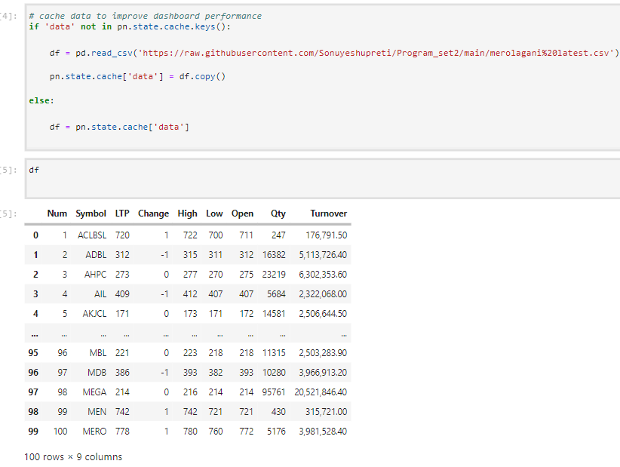
In our progress we work on showing some important information from the database in Python
Connecting database of Merolagani with the Jupiter notebook
Main libraries:
-Pandas is a python library that is used more for data science/data analytics and machine learning tasks.
-NumPy is a library for the Python programming language that supports creating large multidimensional vectors and matrices.

Slide 17
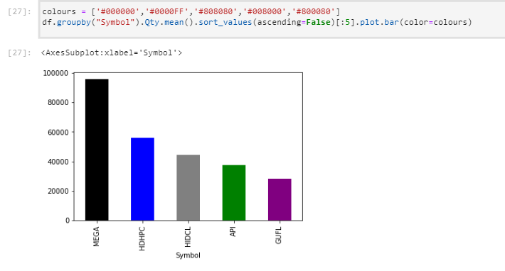
Bar diagram representing Symbol Vs Average quantity of various companies.
Mega Bank is found to have the largest among all.

Slide 18
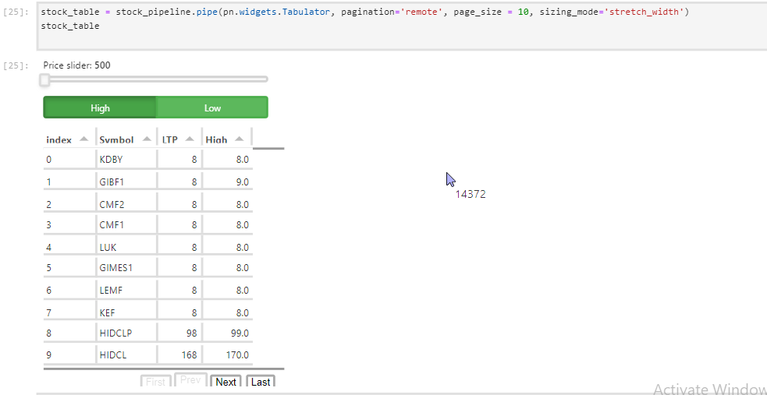
Generating table from the database to visualize futher

Slide 19
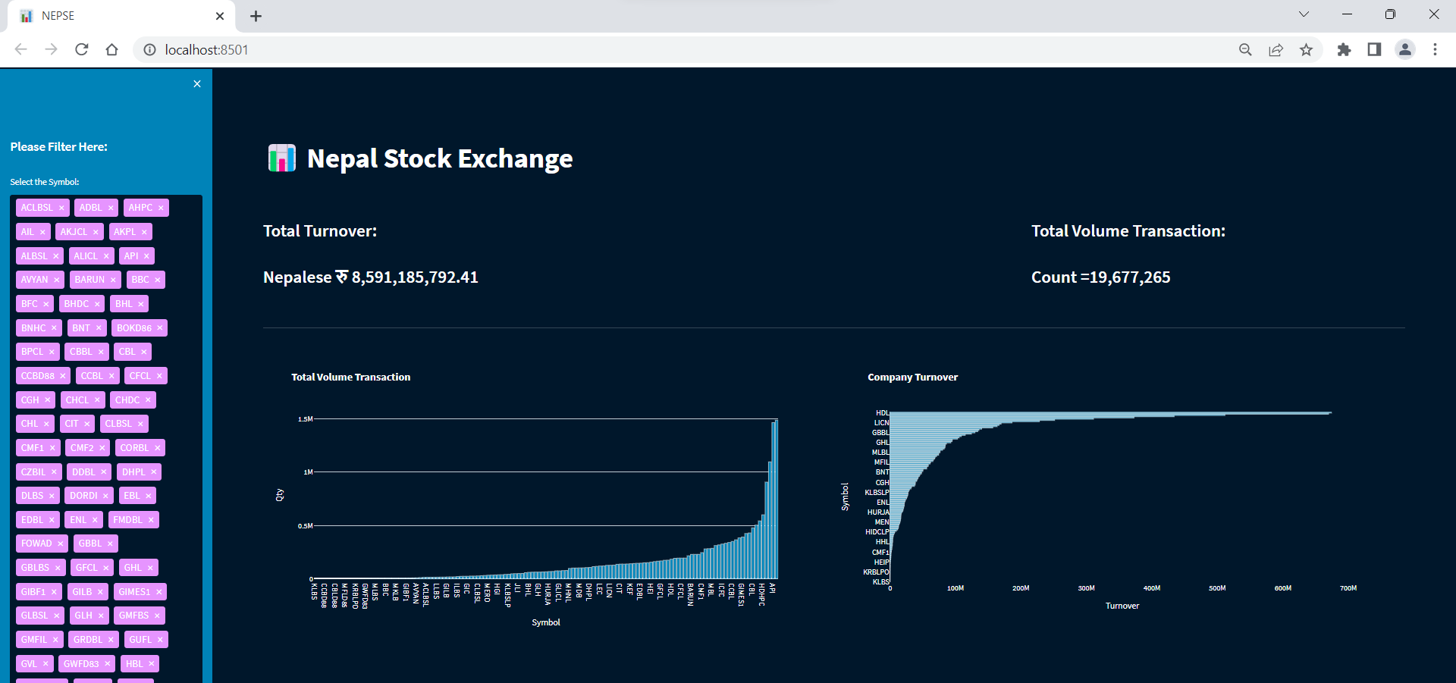

Slide 20
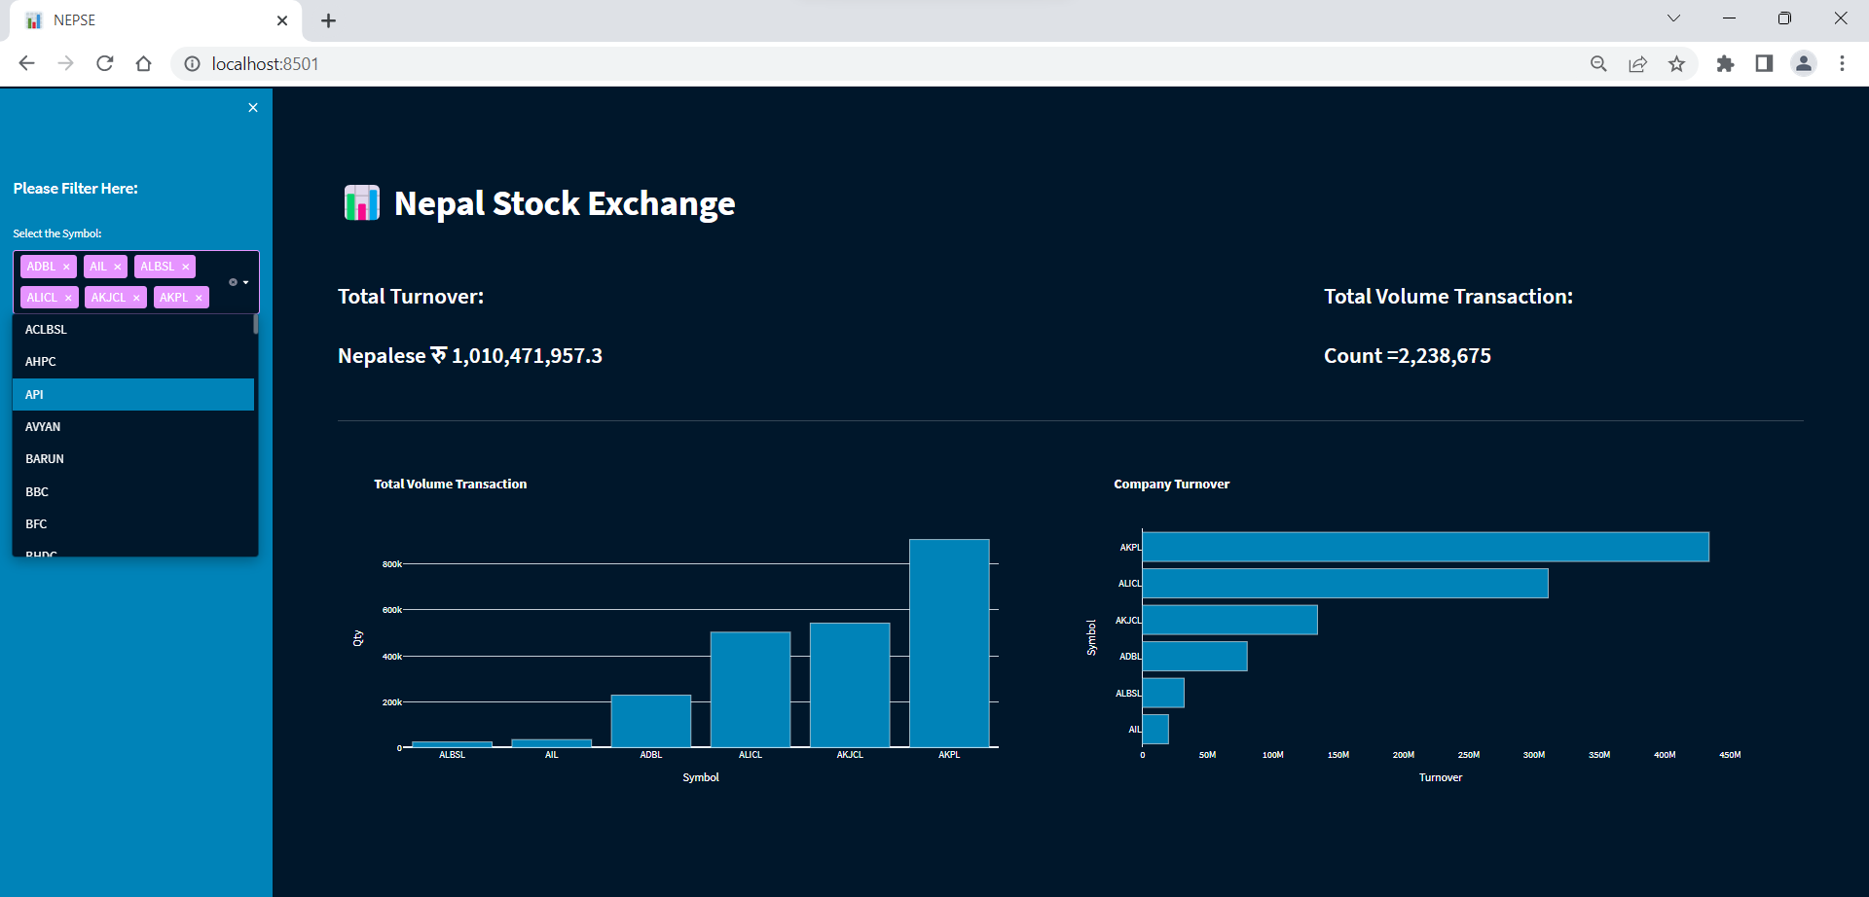

Slide 21
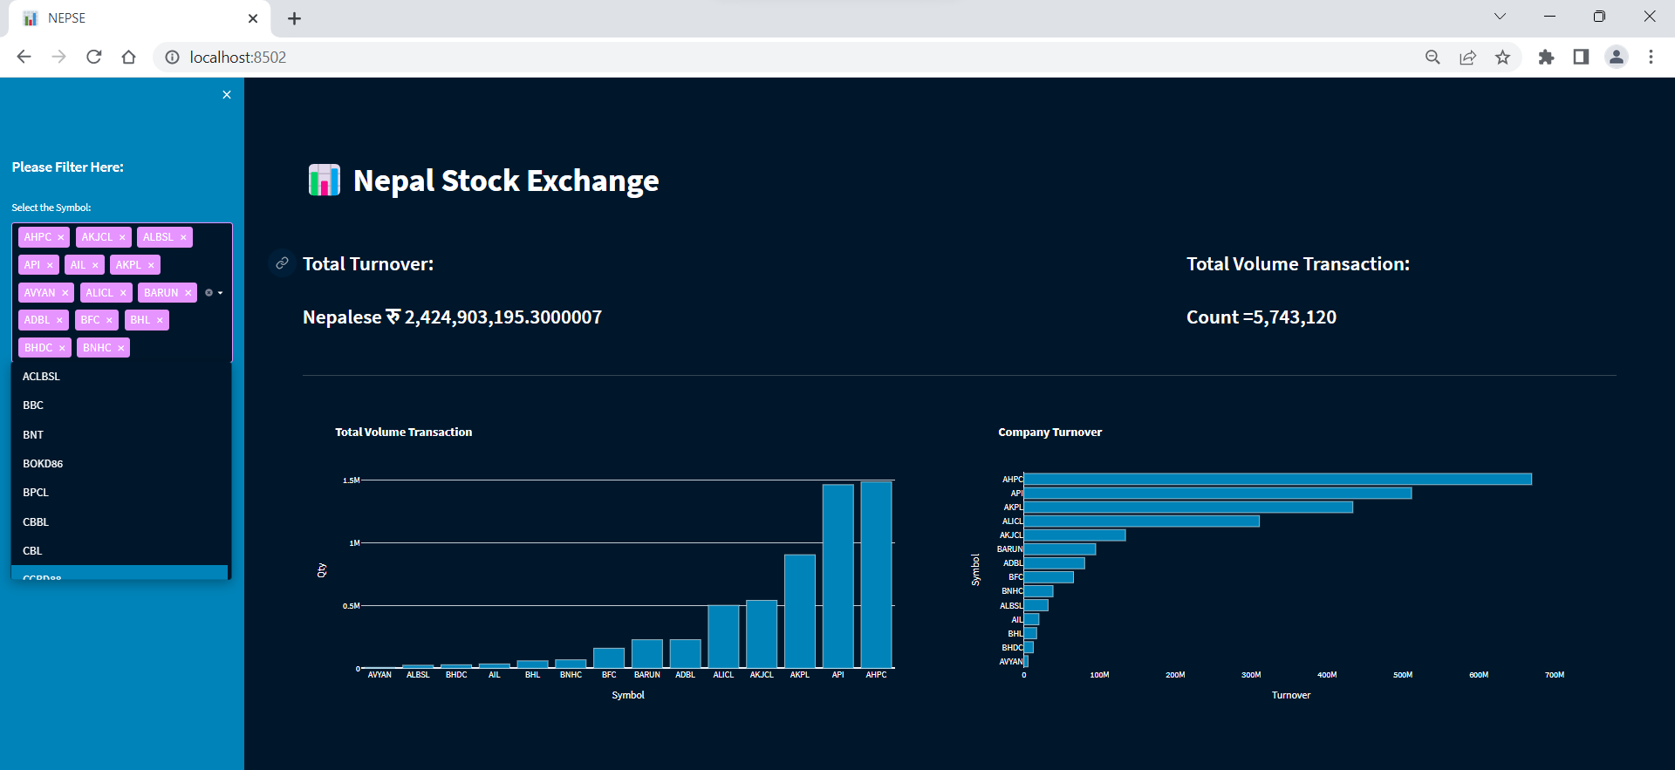

Slide 22
Conclusions
Acquired knowledge in practice of new frameworks and environments that we had never used before.
We apply problem solving skills when facing different problems during the creation of tasks
We practice research and teamwork skills, following a specific role.
Added to all the technical knowledge learned during the project, our team:

Slide 23

THANKS!
Does anyone have any question?
addyouremail@freepik.com

